Slide 1
Unsecured Connections
An IoT Security Breach
By Linda Osguthorpe, Brandon Sowerby, Jayden Wood, and Leslee Gobelman

Slide 2
Technical Background and research
Vulnerabilities in IoT Devices:
Many IoT devices utilize inadequately secured APIs.
Assumption of authorized access solely based on being on the same local Wi-Fi network.
Lack of password or login authentication requirements for device manipulation.
Exploitation Techniques:
Network scanning to identify vulnerable IoT devices on the wireless network.
Utilization of Python scripting for API exploitation.
Execution of a Denial-of-Service (DoS) attack on the targeted IoT device (Sonos speaker).

Slide 3

Demonstration Preview
Here we will be demonstrating a DoS attack on a Sonos device on a home network. We will be sending a “stop playing” command over and over to a Sonos Beam which will make it inoperable from the normal application.

Slide 4
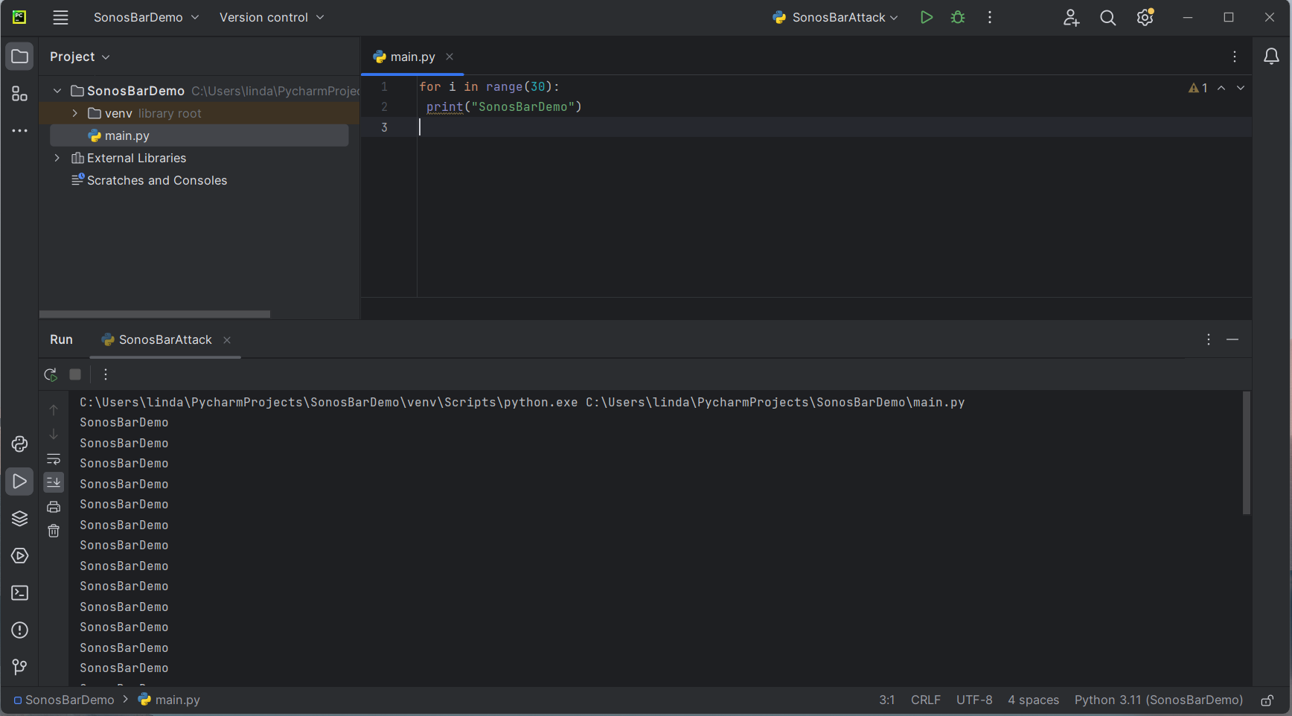
Setup
We will be using the IDE (Integrated Development Environment) Pycharm to execute the code for the attack.

Slide 5
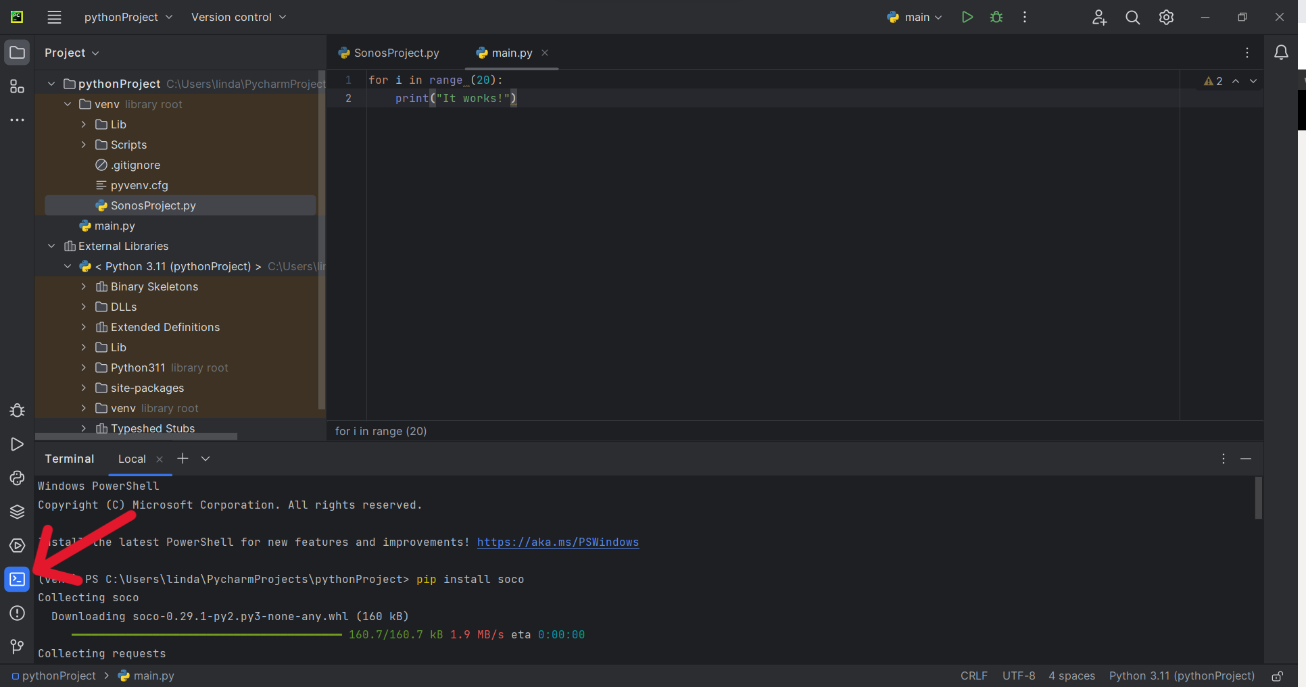
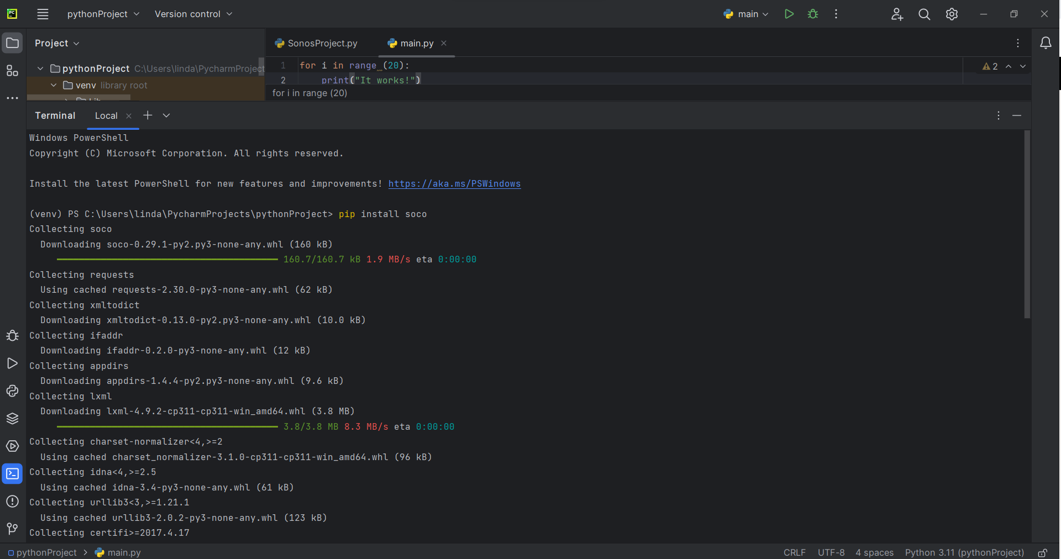
Installation
To control the sonos device while remaining undetected, we will be using the command line to execute the attack.
We will be using the SoCo (Sonos Controller) library to control the Sonos device.

Slide 6
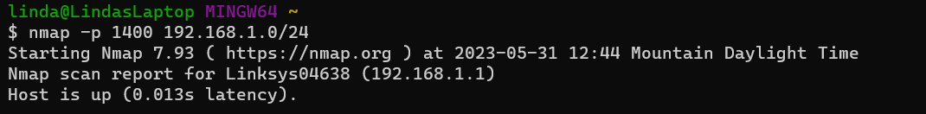
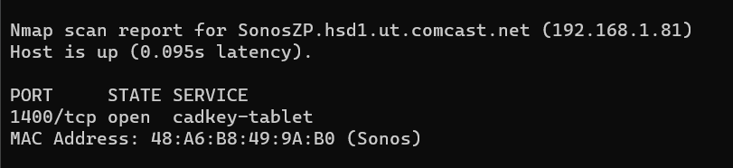
Find Sonos Device with Nmap
Using the command “nmap -p 1400, 192.168.1.0/24” we found the Sonos bar on the network.

Slide 7
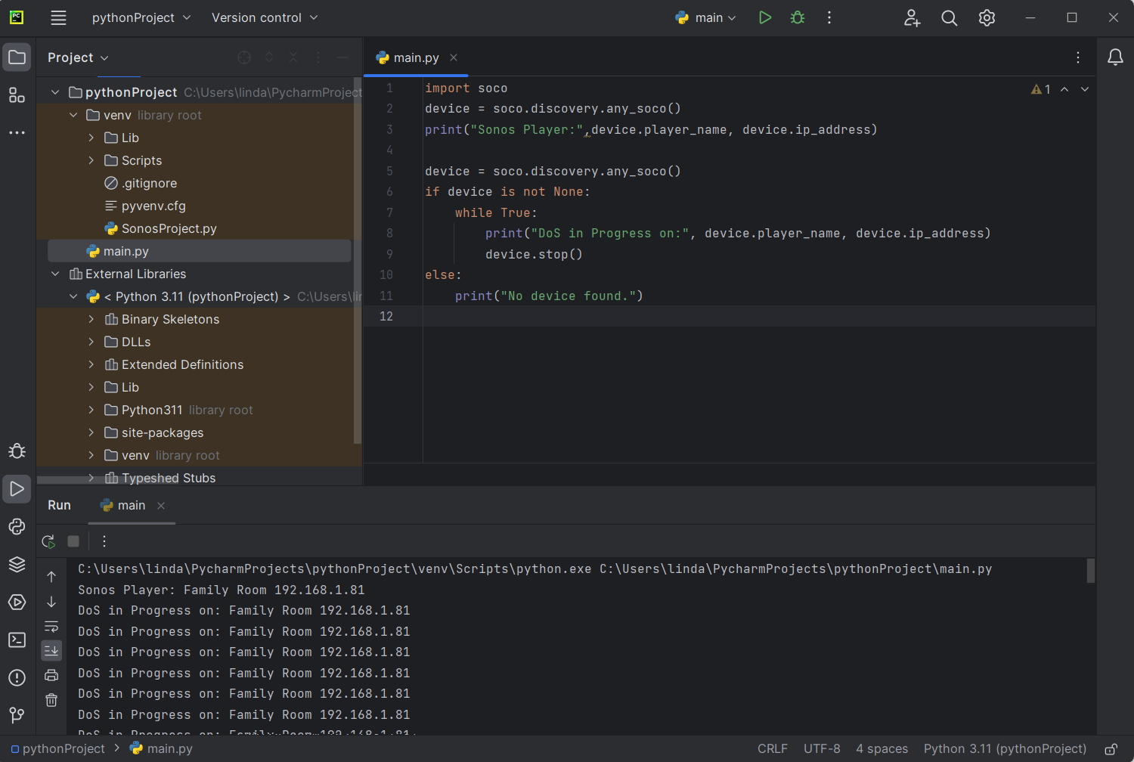
Controlling the Device
Using the script in the shown image you can see that the DoS attack was successful.
The device is inoperable while the DoS attack is in progress.

Slide 8
Demonstration
Enjoy this live demonstration of exploiting an IoT device

Slide 9
Vulnerabilities & Mitigation of a DoS attack on Sonos device:
1. Loss of Connectivity: This vulnerability occurs when a DoS attack overwhelms the network resources, thus severing the connection between the Sonos device and other network services. Think of it as a huge crowd blocking the entrance to the store. To mitigate this, the use of robust network security measures like firewalls, Intrusion Detection Systems, and Intrusion Prevention Systems can be implemented.
2. Unresponsiveness: The Sonos device's ability to process commands is impeded due to a DoS attack, leading to delays or non-responsiveness, think of it as a cashier overwhelmed by too many customers at once. Mitigation involves implementing rate limiting, which regulates the rate of incoming traffic, preventing overwhelming the device.
3. Interruption of Music Playback: A DoS attack disrupts the streaming or playback of music, causing interruptions or complete cessation of audio playback, like a power outage at a concert. One mitigation strategy would be to employ content delivery networks to ensure stable streaming, as they can handle spikes in traffic and mitigate DoS attacks.

Slide 10
Vulnerabilities & Mitigations of a DoS attack (continued):
4. Inability to Discover or Add Devices: A DoS attack disrupts the discovery protocols Sonos devices use to identify and connect with other devices, like a blinding blizzard. Mitigation involves segmenting your network, isolating Sonos devices from other network devices to minimize the attack surface and potential disruption.
5. Firmware and Software Updates: DoS attacks can prevent a Sonos device from downloading and installing updates, Like blocking a package being delivered. To mitigate this, you should schedule updates for off-peak hours when DoS attacks are less likely to occur. In addition, you should use a secured network connection when updating your device to prevent interception and manipulation of the updates.
6. System Instability: This vulnerability arises when a severe DoS attack leads to system crashes or instability in Sonos devices, like a car breaking down. To mitigate this is to implement automated failover and backup mechanisms, ensuring that in case of instability, the system can switch over to a standby system to maintain service continuity.

Slide 11
The End
Thanks for coming to our BootCon talk

